Slide 1

C{}DE-A-TH{}N - 2022
Assignment 3

Slide 2
Q. 1 A. Write a C/C++ or Python program to perform 3D convolution
B. Deploy the above code on GPU using CUDA C++/ CUDA Python
Consider the matrix size sufficiently large eg. 512 x 512 x 512 of type double. (If memory limitation reduce size to 256 x 256 x 256 likewise)
Consider mask size as 9 x 9 x 9 and appropriate pad size
Measure the performance of sequential version and optimized parallel version
Calculate the speedup observed
You may execute sequential programs on your local machine
However all parallel codes must be executed on server
Parallel versions considered for evaluations only if both sequential and parallel codes gives same output

Slide 3
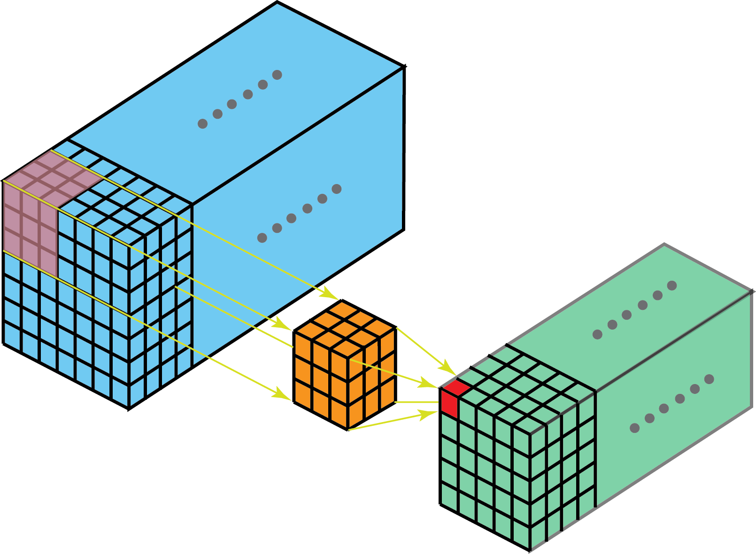
What is 2D and 3D Convolution?
2D
3D

Slide 4
Submission
Explain in brief your parallelization strategy like data splitting, thread/block creation, and allocation etc.
Ans:

Slide 5
Submission
Insert your findings into the below table
Ans:
 | Sequential Time | Parallel version 1 time | Parallel version 2 time | Speedup wrt parallel version 1 | Speedup wrt parallel version 1
3D Conv
Note:- In case if needed you can add more columns if you have implemented multiple parallel
versions

Slide 6
Submission
Comment on your observations such as limitations of proposed solution, etc.
Ans:

Slide 7
Submission
Rename the file as <TEAM_NAME>_Assignment3
Send the presentation file with source code

